Slide 1
Working With MASTML
Aiden Tepper
Informatics Skunkworks (MSE 299), 2 Credits
03-06-2021

Slide 2
Hours Summary
Date | Hours | Description of Work
3/4 | 2 | Worked through first third of instructions document
3/5 | 3 | Worked through rest of instructions document
3/6 | 1 | Clean up work, created slide deck

Slide 3
Progress
The task assigned to us this week was to work through the “Working With MASTML” module
This document walked us through creating, training, optimizing, and testing a ML model on Google Colab software using and manipulating sample data given to us
The best way to represent results from this week’s tasks is through either the output from running the MAST-ML code on the website or through the histograms/parity plots/other data found in the output files of the numerous MAST-ML runs

Slide 4
Problems
I didn’t encounter any major issues while working with Google Colab or the MAST-ML library
I struggled a little to understand exactly what was going on during certain steps, but paying closer attention to the details of the instructions document helped me work through the procedure while maintaining a grasp of what was going on behind the scenes

Slide 5
Questions
The only questions I really have from this week have to do with the MAST-ML library itself
I don’t fully understand what Kernel Ridge means and would love to explore that
I also am not clear on what kind of machine learning model the MAST-ML library creates behind the scenes

Slide 6
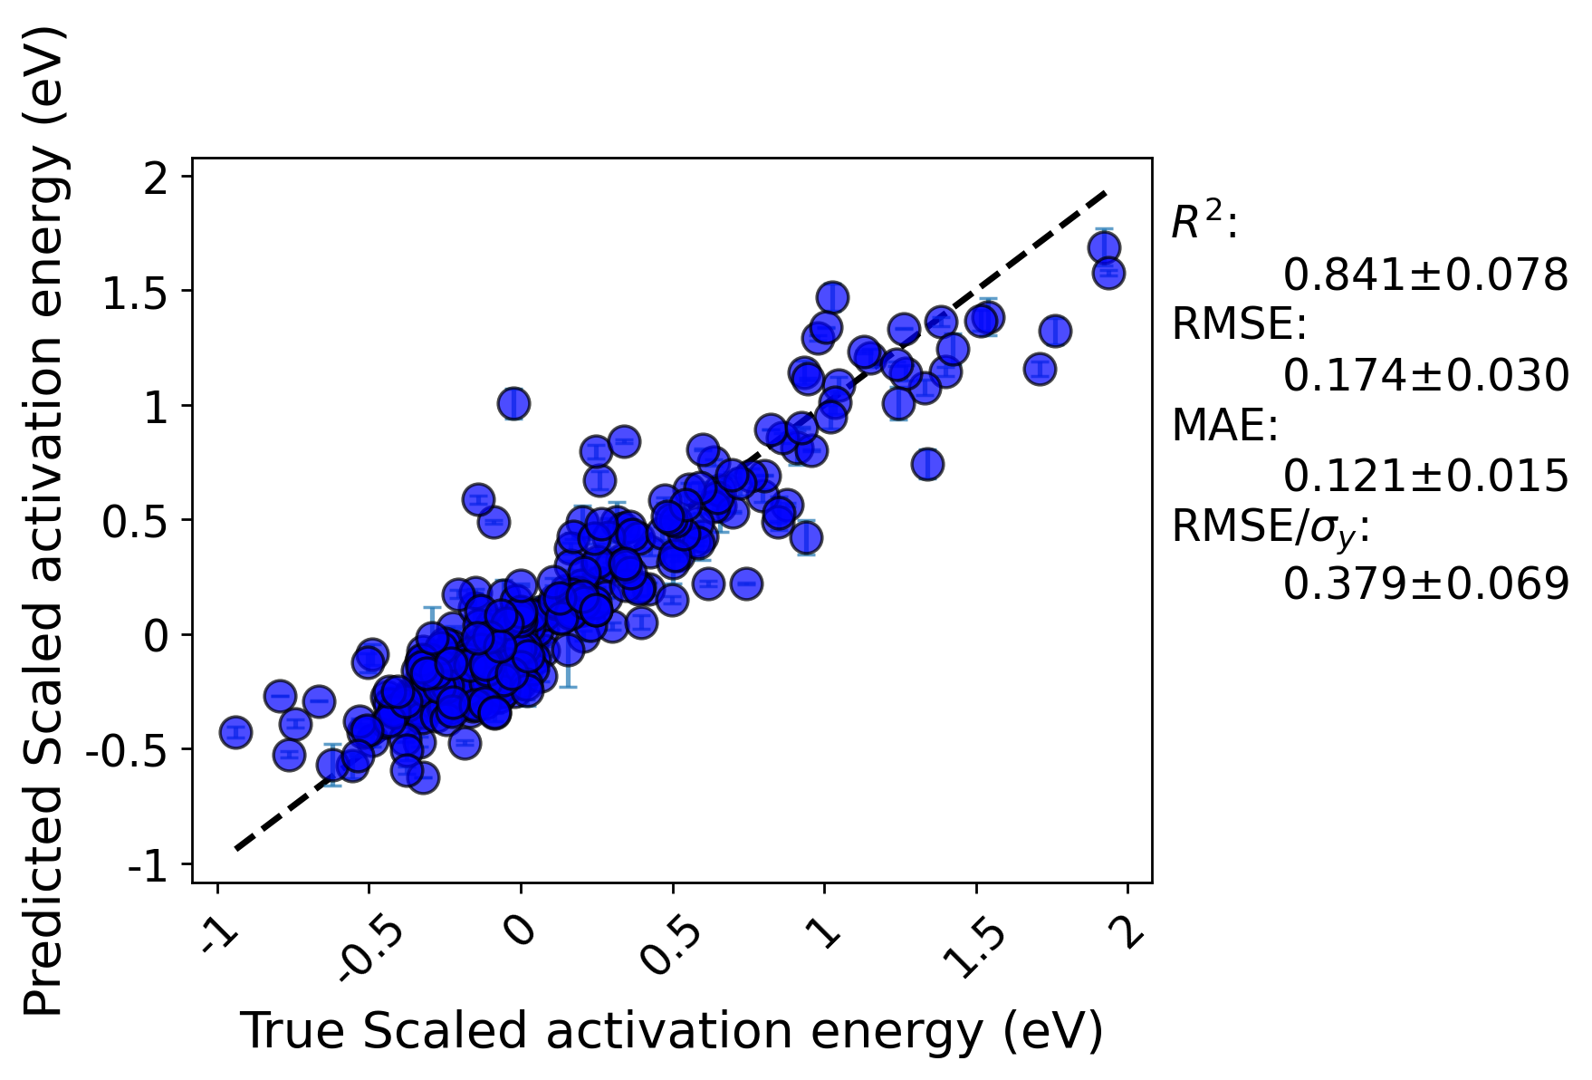
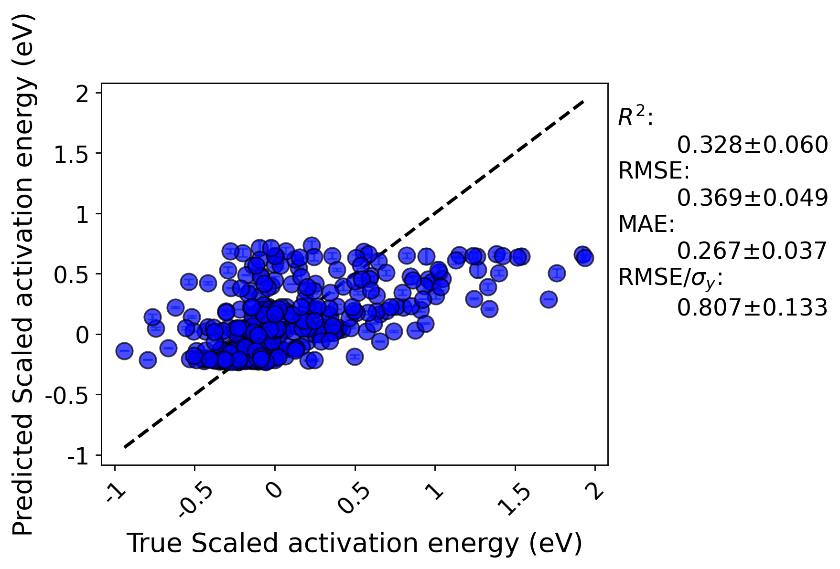
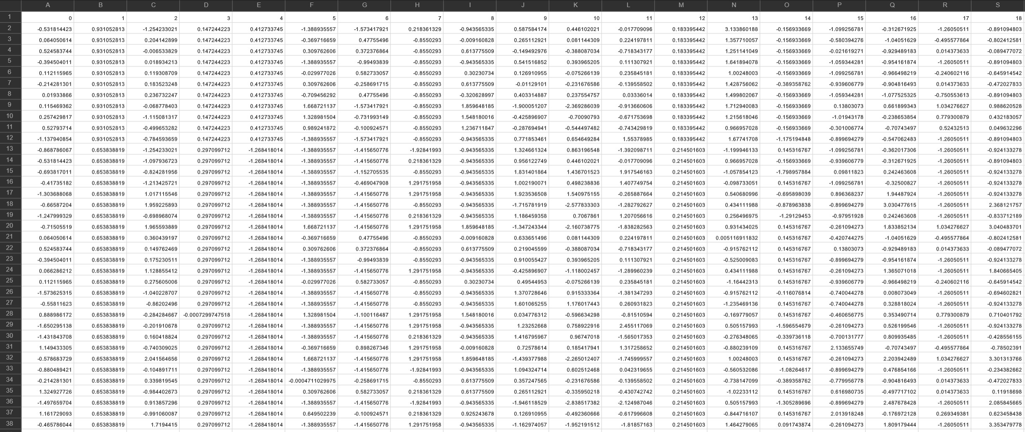
Assessment Figures

